Slide 1
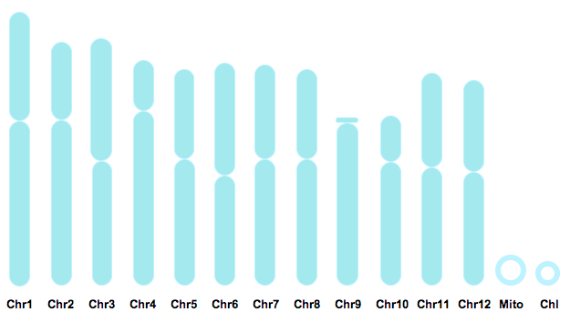
3.2 Chromosomes
Essential idea: Chromosomes carry genes in a linear sequence that is shared by members of a species.
The asian rice (Oryza sativa) genome can be seen illustrated above. Rice possesses up 63,000 genes divided up between 12 chromosomes.
Below is a map of part of the first chromosome showing the gene loci present on it. Although different varieties (estimated 40,000 worldwide) will possess different alleles for genes, all individuals will share the same twelve chromosomes and the alleles of each variety will occur at the same position on same chromosome, i.e. at the same gene loci.
By Chris Paine
https://bioknowledgy.weebly.com/
http://www.cambia.org/daisy/RiceGenome/2959/version/default/part/ImageData/data/Rice%20chromosomes.png
http://rgp.dna.affrc.go.jp/E/publicdata/naturegenetics/chr01.gif

Slide 2
Understandings
 | Statement | Guidance
3.2.U1 | Prokaryotes have one chromosome consisting of a circular DNA molecule.
3.2.U2 | Some prokaryotes also have plasmids but eukaryotes do not.
3.2.U3 | Eukaryote chromosomes are linear DNA molecules associated with histone proteins.
3.2.U4 | In a eukaryote species there are different chromosomes that carry different genes.
3.2.U5 | Homologous chromosomes carry the same sequence of genes but not necessarily the same alleles of those genes.
3.2.U6 | Diploid nuclei have pairs of homologous chromosomes.
3.2.U7 | Haploid nuclei have one chromosome of each pair. | The two DNA molecules formed by DNA replication prior to cell division are considered to be sister chromatids until the splitting of the centromere at the start of anaphase. After this, they are individual chromosomes.
3.2.U8 | The number of chromosomes is a characteristic feature of members of a species.
3.2.U9 | A karyogram shows the chromosomes of an organism in homologous pairs of decreasing length. | The terms karyotype and karyogram have different meanings. Karyotype is a property of a cell - the number and type of chromosomes present in the nucleus, not a photograph or diagram of them.
3.2.U10 | Sex is determined by sex chromosomes and autosomes are chromosomes that do not determine sex.

Slide 3
Applications and Skills
 | Statement | Guidance
3.2.A1 | Cairns’ technique for measuring the length of DNA molecules by autoradiography.
3.2.A2 | Comparison of genome size in T2 phage,Escherichia coli, Drosophila melanogaster, Homo sapiens and Paris japonica. | Genome size is the total length of DNA in an organism. The examples of genome and chromosome number have been selected to allow points of interest to be raised.
3.2.A3 | Comparison of diploid chromosome numbers of Homo sapiens, Pan troglodytes, Canis familiaris, Oryza sativa, Parascaris equorum.
3.2.A4 | Use of karyograms to deduce sex and diagnose Down syndrome in humans.
3.2.S1 | Use of databases to identify the locus of a human gene and its polypeptide product.

Slide 4
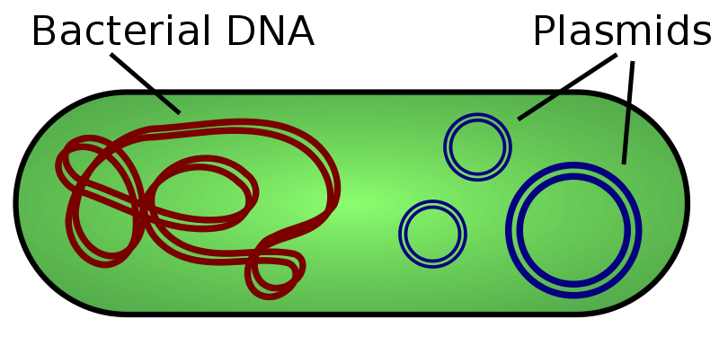
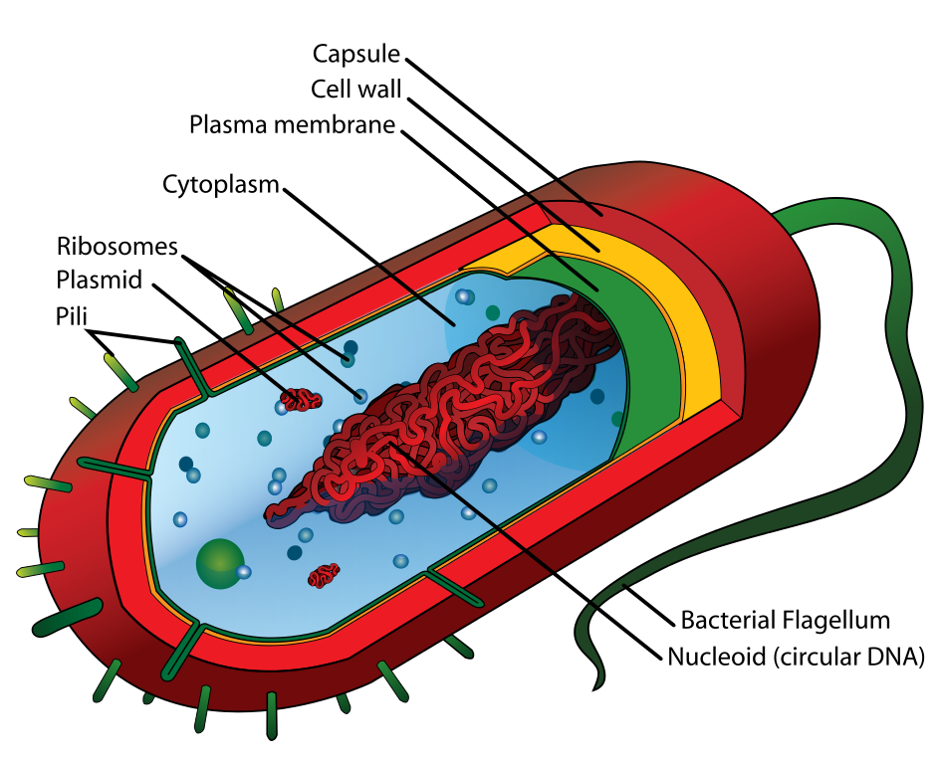
3.2.U1 Prokaryotes have one chromosome consisting of a circular DNA molecule.
3.2.U2 Some prokaryotes also have plasmids but eukaryotes do not.
Prokaryotes have two types of DNA:
single chromosome
plasmids
The single prokaryotic chromosome is coiled up and concentrated in the nucleoid region.
Because there is only a single chromosome there is only one copy of each gene.
A copy of the chromosome is made just before cell division (by binary fission).
https://commons.wikimedia.org/wiki/File:Plasmid_%28english%29.svg
https://commons.wikimedia.org/wiki/File:Average_prokaryote_cell-_en.svg

Slide 5
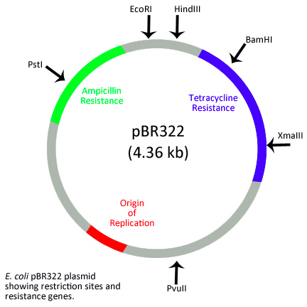
3.2.U2 Some prokaryotes also have plasmids but eukaryotes do not.
Prokaryote bacteria may have plasmids, but these structures are not found in eukaryotes.*
Features of Plasmids:
Naked DNA - not associated with histone proteins
Small circular rings of DNA
Not responsible for normal life processes – these are controlled by the nucleoid chromosome
Commonly contain survival characteristics, e.g. antibiotic resistance
Can be passed between prokaryotes
Can be incorporated into the nucleoid chromosome
n.b. Plasmid characteristics mean that Scientists have found them useful in genetic engineering. Plasmids can be used to transfer genes into bacteria.
*Scientists have found plasmids in archea and eukaryota, but very rarely.
https://commons.wikimedia.org/wiki/File:Plasmid_%28english%29.svg
https://en.wikipedia.org/wiki/File:PBR322_plasmid_showing_restriction_sites_and_resistance_genes.jpg

Slide 6
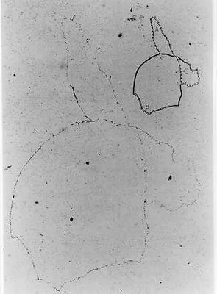
3.2.A1 Cairns’ technique for measuring the length of DNA molecules by autoradiography. AND Nature of Science: Developments in research follow improvements in techniques - autoradiography was used to establish the length of DNA molecules in chromosomes. (1.8)
John Cairns produced images of DNA molecules from Escherichia coli (E.coli)
E. Coli was grown with thymidine containing a radioactive isotope of hydrogen (the DNA was labelled).
The E. Coli cells were broken open by enzymes to release the cell contents
The cell contents were applied to a photographic emulsion and placed in the dark (for two months)
The radioative isotopes reacted with the emulsion (similarly to light does)
Dark areas on the photographic emulsion indicated the presence of DNA
The images showed that E. coli possesses a single circular chromosome which is 1,100 μm long (E. coli cells have a length of only 2 μm)
Cairns images also provided evidence to support the theory of semi-conservative replication
n.b. The insights and improvements in theory would not have been possible without the development and use of autoradiography (exposure of photographic emulsion by radioactive isotopes).
http://schaechter.asmblog.org/.a/6a00d8341c5e1453ef017c37accbac970b-300wi

Slide 7
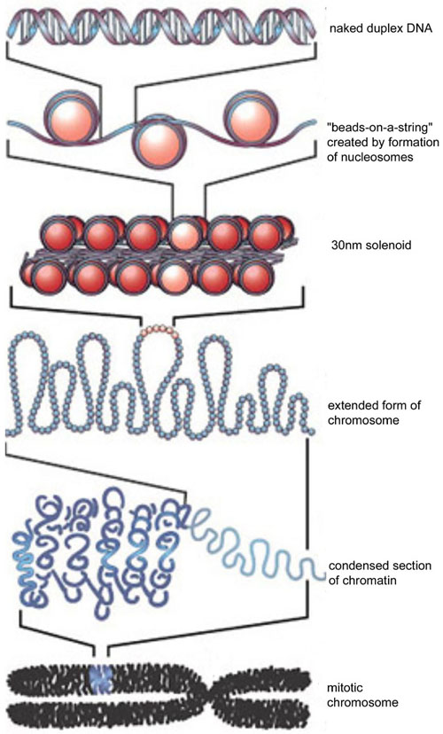
3.2.U3 Eukaryote chromosomes are linear DNA molecules associated with histone proteins.
Linear strands of DNA held in a helix
Eukaryotic chromosomes may be up to 85mm in length. To fit such a length of DNA into a nucleus with a diameter of 10 μm it has to be coiled in a predictable fashion that still allows for processes, such as replication and protein synthesis, to occur.
Nucleosomes are formed by wrapping DNA around histone proteins
n.b. Prokaryotic DNA is, like eukaryotic DNA, supercoiled, but differently: Prokaryotic DNA maybe associated with proteins, but it is not organised by histones and is therefore sometimes referred as being ‘naked’.
http://en.wikipedia.org/wiki/File:DNA_to_Chromatin_Formation.jpg

Slide 8
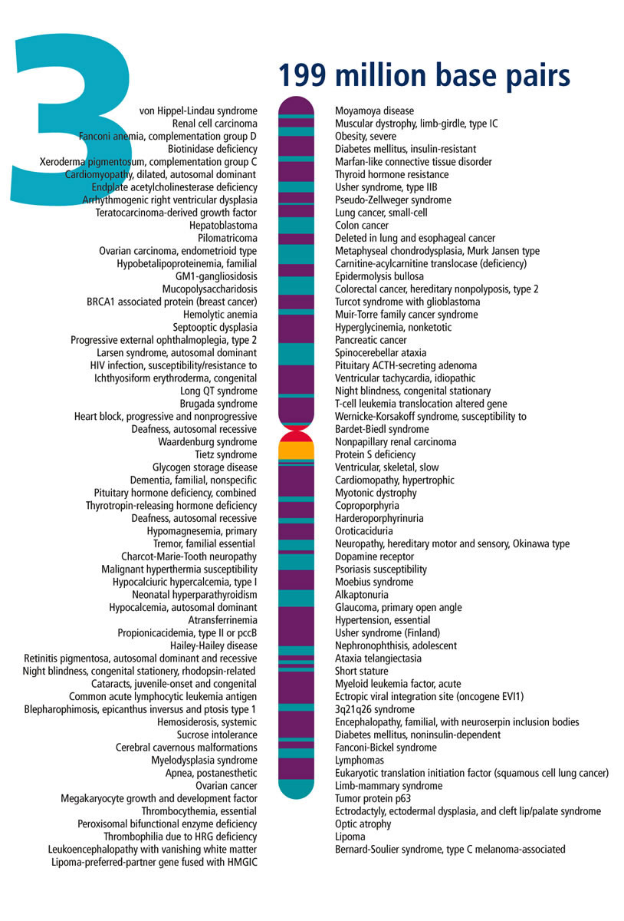
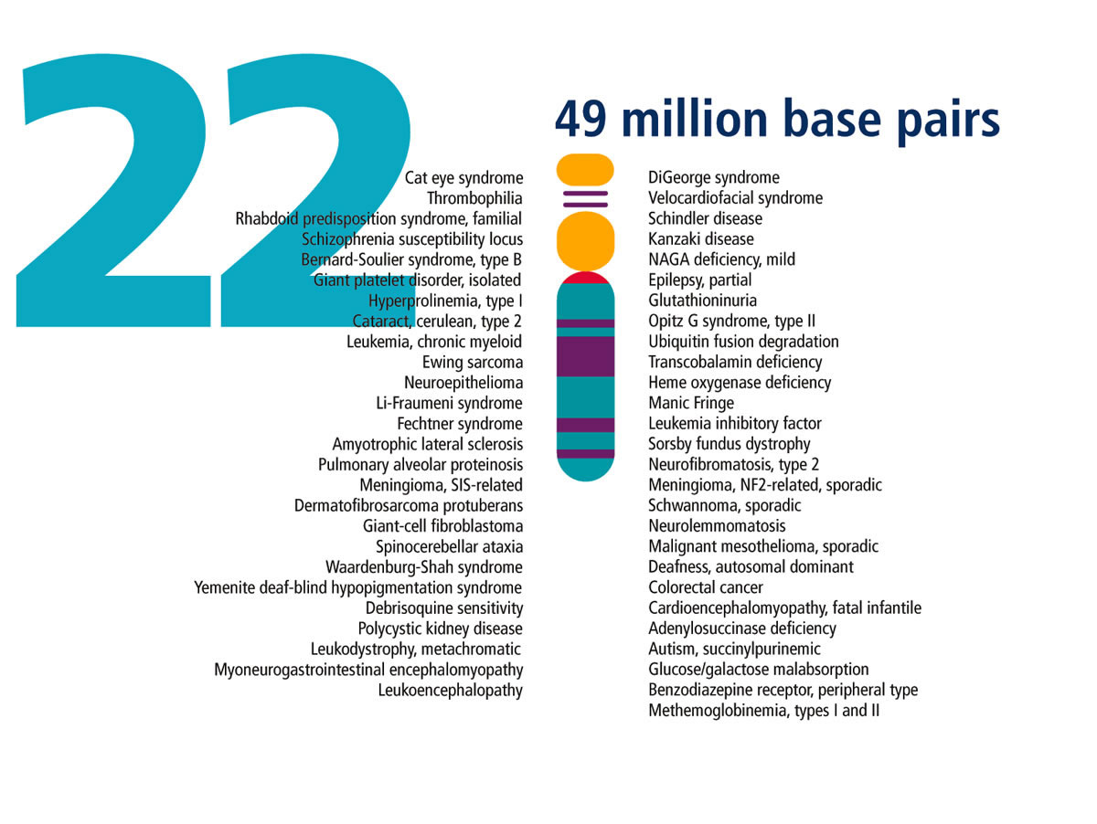
3.2.U4 In a eukaryote species there are different chromosomes that carry different genes.
Eukaryotes possess multiple chromosomes. All individuals of a species possess the same chromosomes, with the same gene loci. For example all humans have twenty three pairs.
Chromosomes can vary by:
Length – the number of base pairs in the DNA molecule
Position of the centromere
Genes occur at a specific locus (location), i.e. it is always found at the same position on the same chromosome (the locus and genes possessed vary between species)
https://public.ornl.gov/site/gallery/originals/

Slide 9
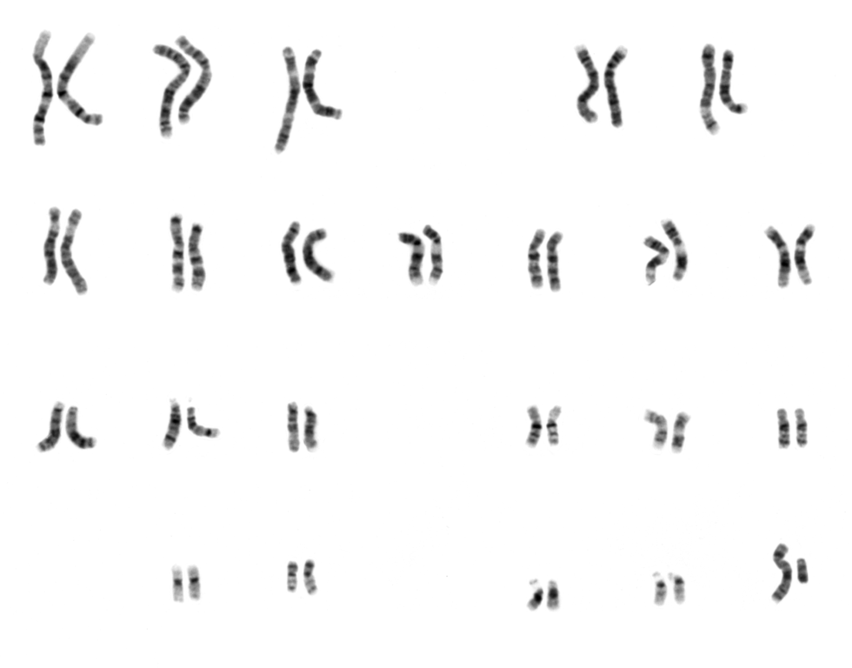
3.2.U8 The number of chromosomes is a characteristic feature of members of a species.
The chromosome number is an important characteristic of the species.
Organisms with different numbers of chromosomes are unlikely to be able to interbreed successfully
Chromosomes can fuse or spit during evolution – these are rare events and chromosome numbers tend to stay the same for millions of years.
A chromosome number does reflect the complexity of an organism
The number of chromosomes possessed by a species is known as the N number, for example humans have 23 different chromosomes.
https://commons.wikimedia.org/wiki/File:NHGRI_human_male_karyotype.png

Slide 10
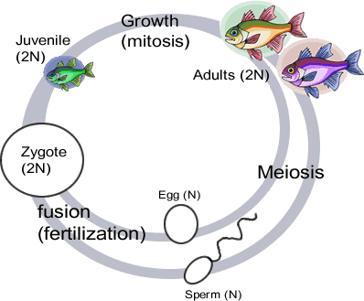
3.2.U6 Diploid nuclei have pairs of homologous chromosomes. AND 3.2.U7 Haploid nuclei have one chromosome of each pair.
A diploid nucleus has two of each chromosome (2N). Therefore diploid nuclei have two copies of every gene, apart from the genes on the sex chromosomes. For example the Diploid nuclei in humans contain 46 chromosomes.
The fertilised egg cell (Zygote) therefore is a diploid (2N) cell containing two of each chromosome.
Gametes are the sex cells that fuse together during sexual reproduction. Gametes have haploid nuclei, so in humans both egg and sperm cells contain 23 chromosomes.
A haploid nucleus has one of each chromosome (N). Haploid nuclei in humans have 23 different chromosomes.
n.b. Diploid nuclei are less susceptible to genetic diseases: have two copies of a gene means organisms are more likely to possess at least one healthy copy.
http://www.biologycorner.com/resources/diploid_life_cycle.gif

Slide 11
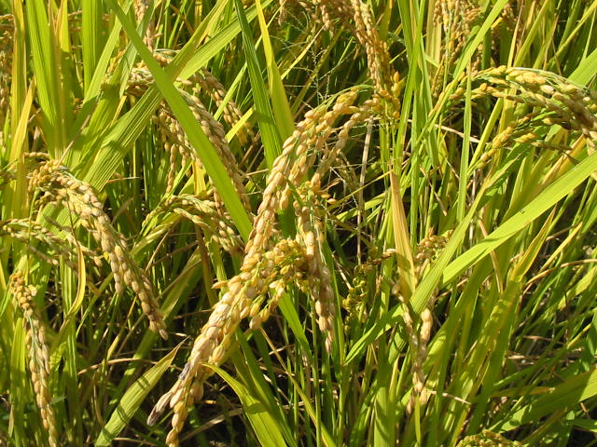
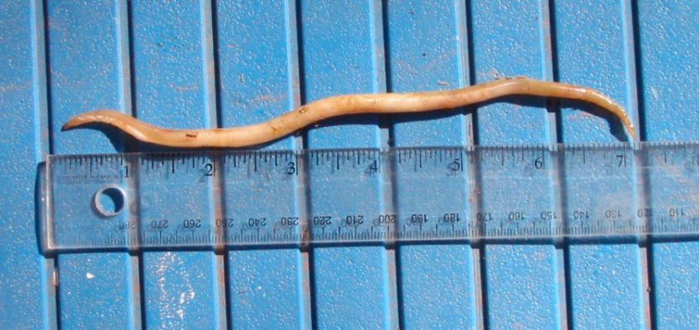
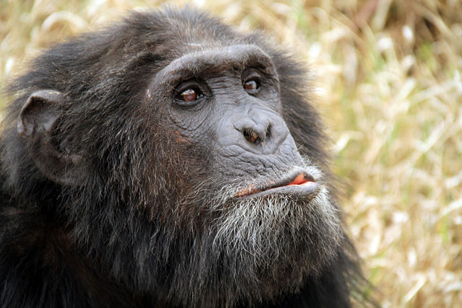
3.2.A3 Comparison of diploid chromosome numbers of Homo sapiens, Pan troglodytes, Canis familiaris, Oryza sativa, Parascaris equorum.
Asian rice (Oryza sativa)
24
2
Equine roundworm (Parascaris equorum)
http://pic20.picturetrail.com/VOL176/4853602/20795519/357799225.jpg
How many diploid chromosomes does each species possess?
https://commons.wikimedia.org/wiki/File:Hinohikari.jpg
Domestic Dog (Canis familiaris)
78
48
Chimpanzee (Pan troglodytes)
https://commons.wikimedia.org/wiki/File:Dog_%28Canis_lupus_familiaris%29_%281%29.jpg
https://commons.wikimedia.org/wiki/File:Pan_troglodytes_Sweetwaters_Chimpanzee_Sanctuary,_Kenya.jpg

Slide 12
3.2.U5 Homologous chromosomes carry the same sequence of genes but not necessarily the same alleles of those genes.

Slide 13
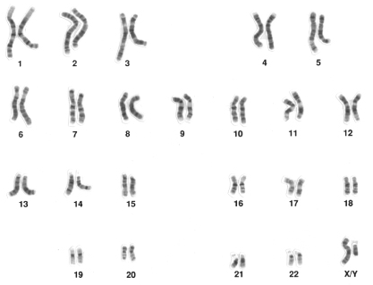
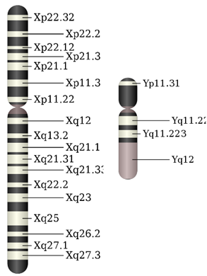
3.2.U10 Sex is determined by sex chromosomes and autosomes are chromosomes that do not determine sex.
Sex Determination: It’s all about X and Y…
Humans have 23 pairs of chromosomes in diploid somatic cells (n=2).
22 pairs of these are autosomes, which are homologous pairs.
One pair is the sex chromosomes.
XX gives the female gender, XY gives male.
Karyotype of a human male, showing X and Y chromosomes:
http://en.wikipedia.org/wiki/Karyotype
SRY
The X chromosome is much larger than the Y.
X carries many genes in the non-homologous region which are not present on Y.
The presence and expression of the SRY gene on Y leads to male development.
Chromosome images from Wikipedia:
http://en.wikipedia.org/wiki/Y_chromosome

Slide 14
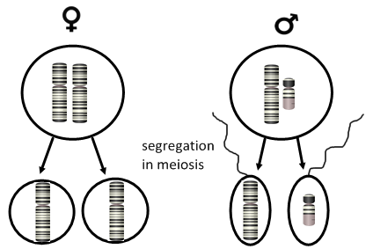
3.2.U10 Sex is determined by sex chromosomes and autosomes are chromosomes that do not determine sex.
Sex Determination: It’s all about X and Y…
Chromosome pairs segregate in meiosis.
Females (XX) produce only eggs containing the X chromosome.
Males (XY) produce sperm which can contain either X or Y chromosomes.
Segregation of the sex chromosomes in meiosis.
SRY gene determines maleness.
Find out more about its role and just why do men have nipples?
gametes | X | Y
X | XX | XY
X | XX | XY
Therefore there is an even chance*
of the offspring being male or female.
http://www.hhmi.org/biointeractive/gender/lectures.html
Chromosome images from Wikipedia:
http://en.wikipedia.org/wiki/Y_chromosome

Slide 15
3.2.A2 Comparison of genome size in T2 phage, Escherichia coli, Drosophila melanogaster, Homo sapiens and Paris japonica.
Humans (Homo sapiens)
3.2 billion base pairs
Genome size is the total number of DNA base pairs in one copy of a haploid genome.
https://upload.wikimedia.org/wikipedia/commons/f/f6/Usain_Bolt_100_m_Daegu_2011.jpg

Slide 16
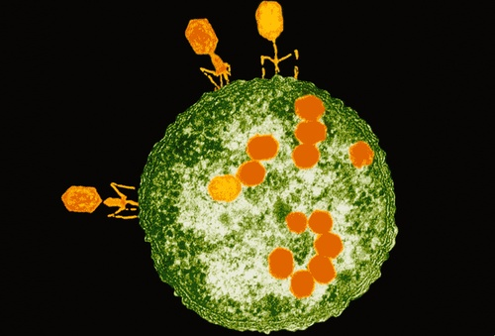
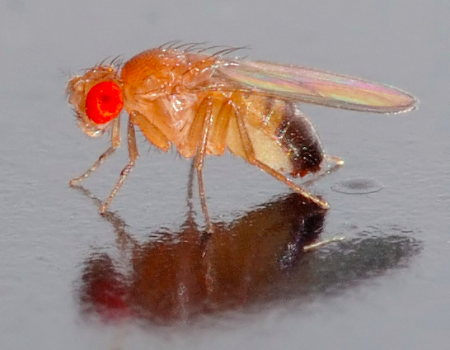
3.2.A2 Comparison of genome size in T2 phage, Escherichia coli, Drosophila melanogaster, Homo sapiens and Paris japonica.
T2 phage
Canopy plant (Paris japonica)
164 thousand base pairs
150 billion base pairs
Escherichia coli
4.6 million base pairs
https://s-media-cache-ak0.pinimg.com/736x/2d/0e/3e/2d0e3ea8ddf652f25a5f2c3b1050af79.jpg
n.b. T2 phage (orange) is a virus that attacks E. Coli bacterium (green and white).
What is the genome size of each species?
Fruit fly (Drosophila melanogaster)
130 million base pairs
https://commons.wikimedia.org/wiki/File:Drosophila_melanogaster_-_side_%28aka%29.jpg
https://commons.wikimedia.org/wiki/File:Paris_japonica_Kinugasasou_in_Hakusan_2003_7_27.jpg

Slide 17
3.2.U9 A karyogram shows the chromosomes of an organism in homologous pairs of decreasing length.
Karyogram is a diagram or photograph of the chromosomes present in a nucleus (of a eukaryote cell) arranged in homologous pairs of decreasing length.
The chromosomes are visible in cells that are undergoing mitosis – most clearly in metaphase.
Stains used to make the chromosomes visible also give each chromosome a distinctive banding pattern.
A micrograph are taken and the chromosomes are arranged according to their size, shape and banding pattern. They are arranged by size, starting with the longest pair and ending with the smallest.
https://commons.wikimedia.org/wiki/File:NHGRI_human_male_karyotype.png

Slide 18
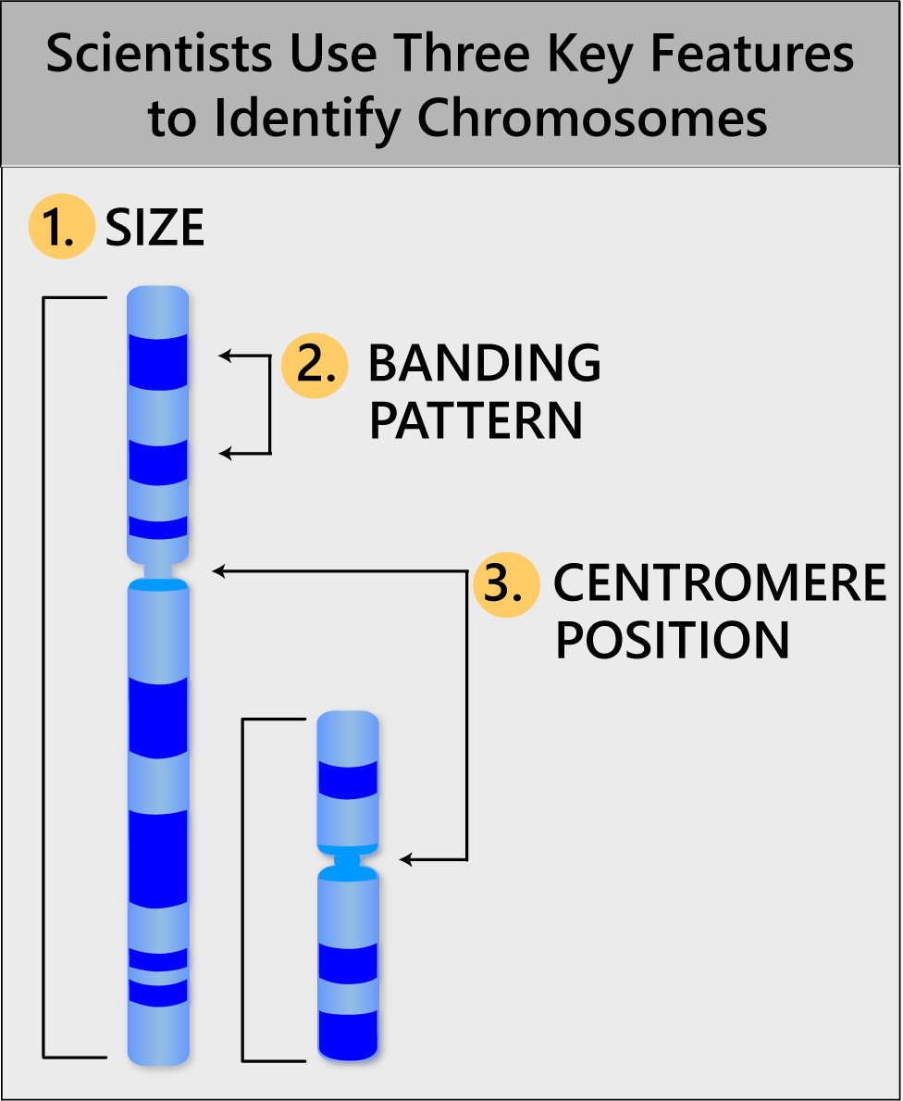
3.2.U9 A karyogram shows the chromosomes of an organism in homologous pairs of decreasing length.
Karyogram is a diagram or photograph of the chromosomes present in a nucleus (of a eukaryote cell) arranged in homologous pairs of decreasing length.
Karyotype is a property of the cell described by the number and type of chromosomes present in the nucleus (of a eukaryote cell).
a Karyogram is a diagram that shows, or can be used to determine, the karyotype.
click to try it
http://learn.genetics.utah.edu/content/chromosomes/karyotype/

Slide 19
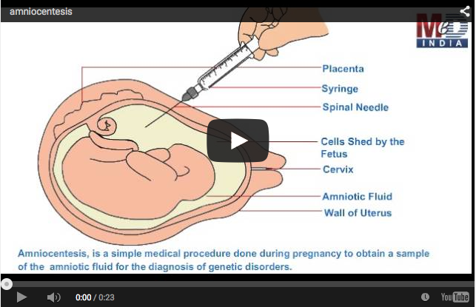
Review: 3.3.A3 Description of methods used to obtain cells for karyotype analysis e.g. chorionic villus sampling and amniocentesis and the associated risks.
Can be carried out in the 16th week of the pregnancy with around a 1% chance of a miscarriage
http://www.medindia.net/animation/amniocentesis.asp

Slide 20
Review: 3.3.A3 Description of methods used to obtain cells for karyotype analysis e.g. chorionic villus sampling and amniocentesis and the associated risks.
Can be carried out in the 11th week of the pregnancy with around a 2% chance of a miscarriage

Slide 21
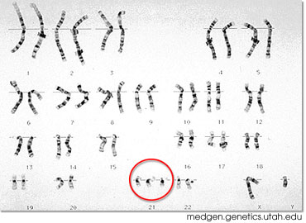
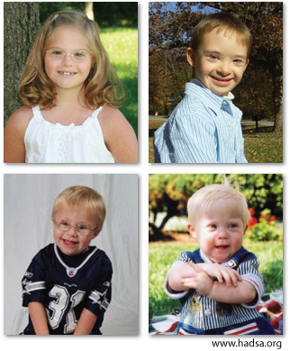
3.2.A4 Use of karyograms to deduce sex and diagnose Down syndrome in humans.
Can you use a karyogram to determine sex and whether a person has Down Syndrome?
Use the Biology Project activity to practice your skills and understanding:
Learn more about:
Diagnosing genetic disorders
Down Syndrome
http://www.biology.arizona.edu/human_bio/activities/karyotyping/karyotyping.html
http://learn.genetics.utah.edu/content/disorders/chromosomal/down/

Slide 22
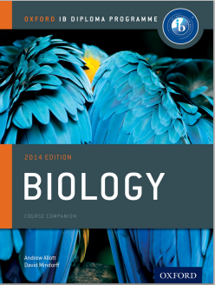
Bibliography / Acknowledgments
Bob Smullen

