Slide 1
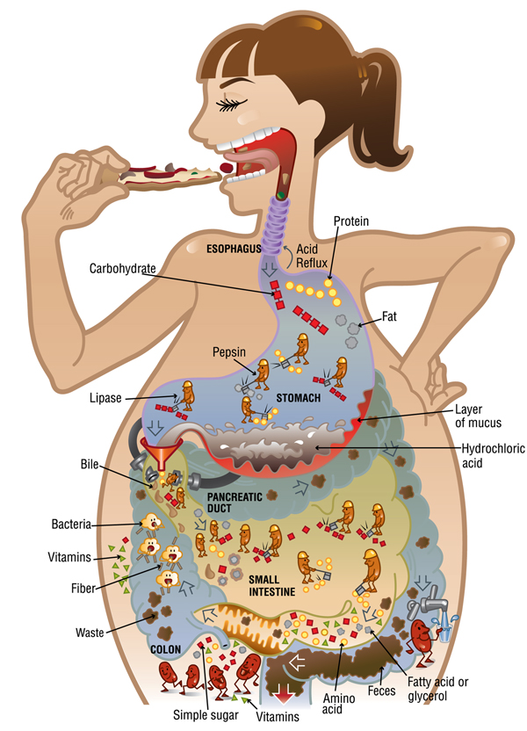
D.2 Digestion

Slide 4
D.2.1 Nervous and hormonal mechanisms control the secretion of digestive juices.
Nervous System
Hormonal Mechanisms
Sight and smell of food triggers immediate pre-ingestion fluids
Food enters stomach and causes distension (stretching)
Gastrin released into bloodstream, stimulates release of stomach acids
Secretin triggers releases from pancreas and liver

Slide 5
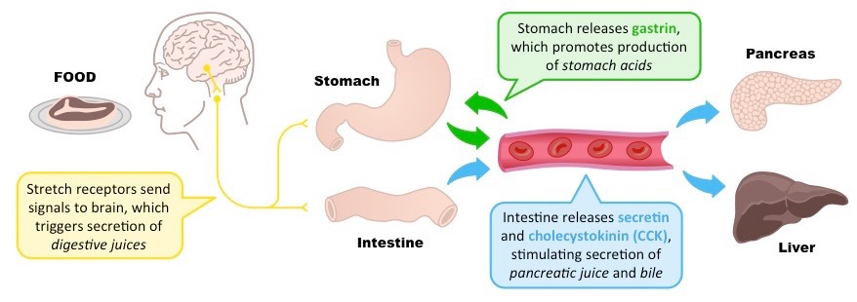
D.2.2 The volume and content of gastric secretions are controlled by nervous and hormonal mechanisms.
Physical stretching = nervous
Positive/Negative Feedback = Hormonal

Slide 6
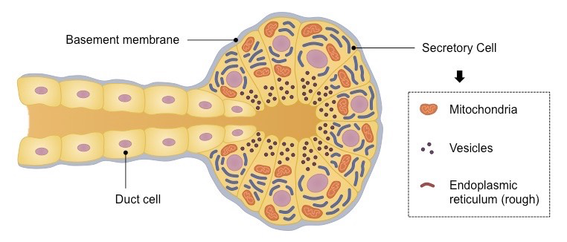
D.2.3 Exocrine glands secrete to the surface of the body or the lumen of the gut.
Sweat, saliva, pancreatic, digestive…
Lots of Golgi, ER and mitochondria. Why?

Slide 7
Micrograph of secretory gland and duct

Slide 8
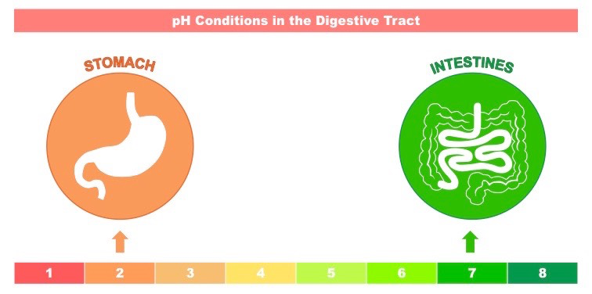
D.2.4 Acid conditions in the stomach favor some hydrolysis reactions and help to control pathogens in ingested food.
Acidic conditions:
activate pepsin enzyme
Prevent pathogenic infections
Help break bonds

Slide 9
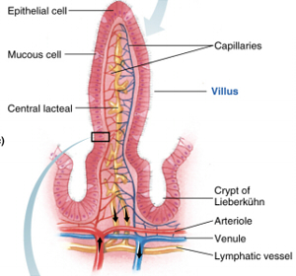
D.2.5 The structure of cells of the epithelium of the villi is adapted to the absorption of food.
Microvilli – Ruffling of epithelial membrane further increases surface area
Rich blood supply – Dense capillary network rapidly transports absorbed products
Single layer epithelium – Minimizes diffusion distance between lumen and blood
Lacteals – Absorbs lipids from the intestine into the lymphatic system
Intestinal glands – Exocrine pits (crypts of Lieberkuhn) release digestive juices
Membrane proteins – Facilitates transport of digested materials into epithelial cells

Slide 10
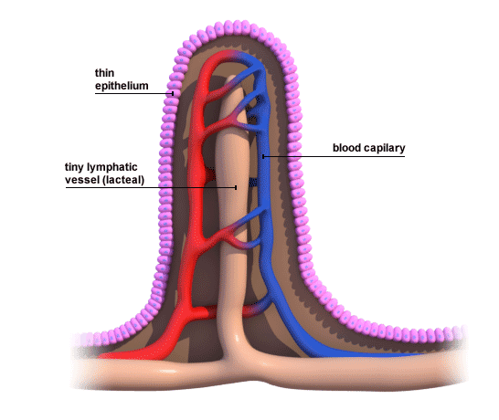

Slide 11
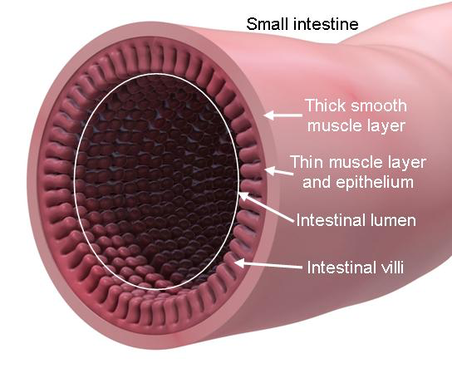

Slide 12
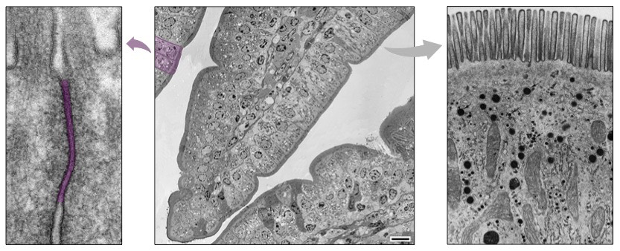
D.2.S1 Identification of exocrine gland cells that secrete digestive juices and villus epithelium cells that absorb digested foods from electron micrographs.
Tight junction
Microvilli
Mitochondria
Pinocytotic vesicles

Slide 13
D.2.6 The rate of transit of materials through the large intestine is positively correlated with their fiber content.
Dietary fiber, or roughage, is the indigestible portion of food from plants and fungi (cellulose, chitin, etc.)
Humans lack the necessary enzymes to break down certain plant matter (e.g. lack cellulose required to digest cellulose)
Certain herbivores (ruminants) possess helpful bacteria in the digestive tract that can break down indigestible plant matter

Slide 14
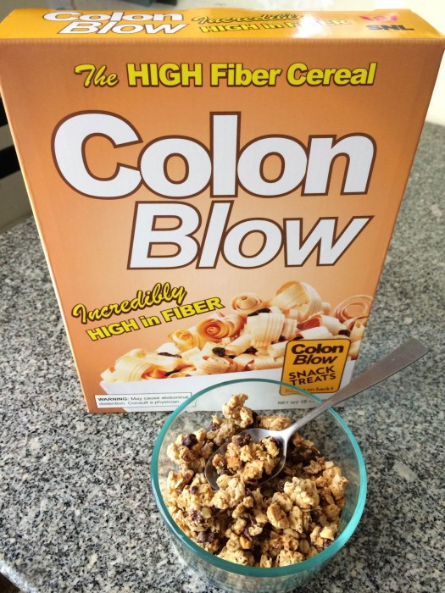
More fiber = faster ‘transit’ through the body

Slide 15
D.2.7 Materials not absorbed are egested.

Slide 16
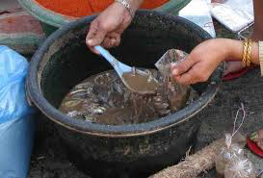
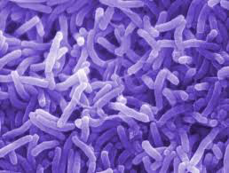
D.2.A1 Dehydration due to cholera toxin
Cholera bacteria creates toxin which creates high ion concentration in lumen
Osmosis draws water our of cells, diarrhea and dehydration can cause death

Slide 17
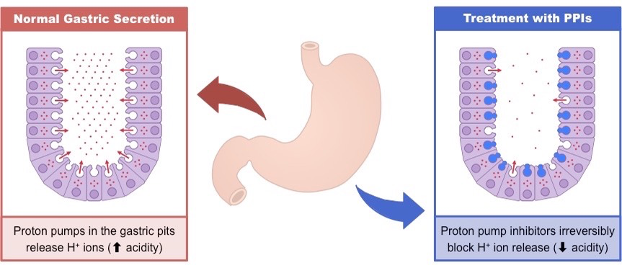
D.2.A.2 The reduction of stomach acid secretion by proton pump inhibitor drugs.
Problems with stomach acidity, like acid reflux, can be managed by proton pump inhibitors
Raises pH and lessens symptoms, limits prevention of infection

Slide 18
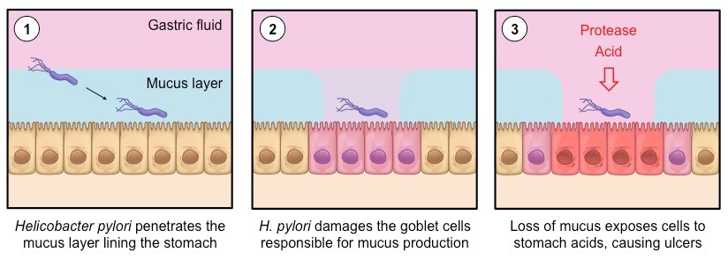
D.2.A.3Helicobacter pylori infection as a cause of stomach ulcers
Stomach ulcers are inflamed and damaged areas in the stomach wall, typically caused by exposure to gastric acids

Slide 19
http://ib.bioninja.com.au/options/option-d-human-physiology/d2-digestion/digestive-juices.html

